Slide 1


GREEN PALATE
Savor the Symphony of GREEN Delights!
Notes:
NOTE: To change images on this slide, select a picture and delete it. Then click the Insert Picture icon
in the placeholder to insert your own image.

Slide 2
Our Website

Slide 3
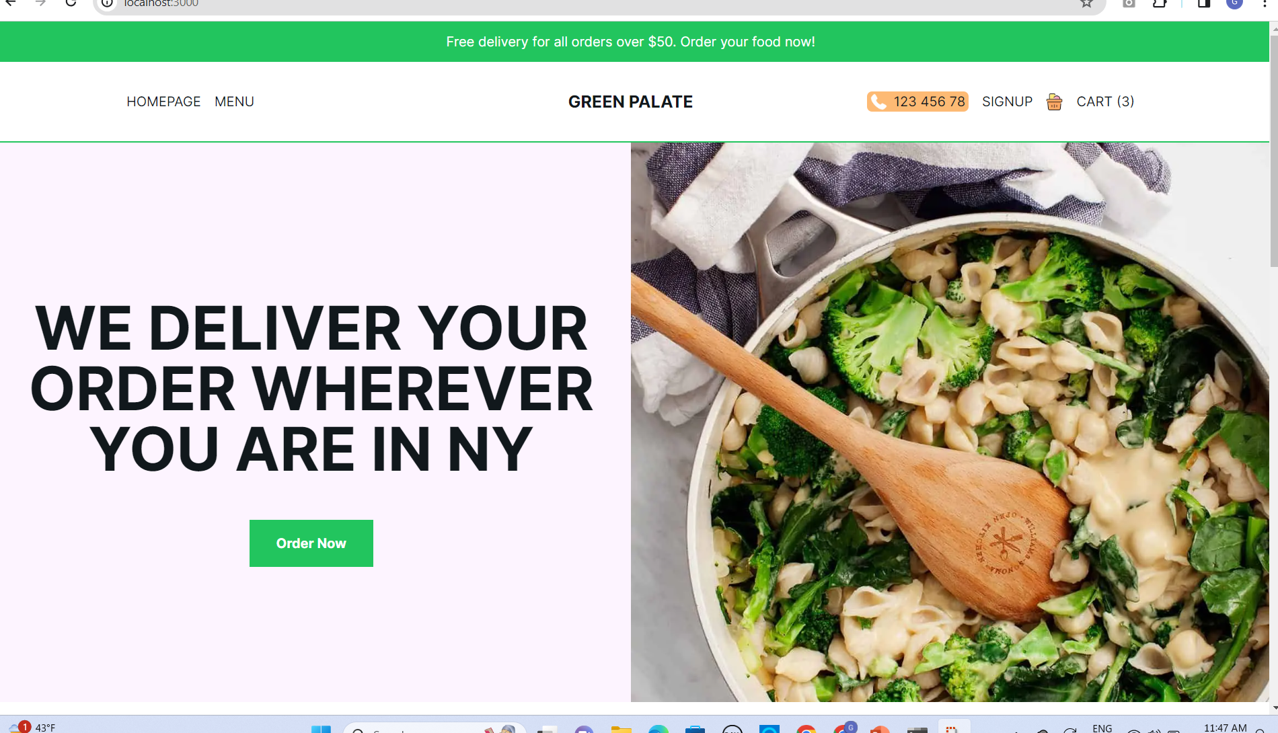

Slide 4
Brand Archetype
Green Palates is not your typical plant-based eatery; it's a bold and innovative culinary adventure committed to rewriting the rules of sustainable dining.
Specializing in a diverse and mouthwatering menu of eco-conscious plant-based dishes, the restaurant embraces the Maverick/Innovator brand archetype.

Slide 5
Methods of Persuation
Ethos (Credibility): • Showcase awards or recognitions for innovative plant-based dishes.
Pathos (Emotion): • Incorporate visually appealing and artistic presentations of dishes.
Logos (Logic): • Provide information on the creative process behind each menu item, appealing to intellectually curious customers.

Slide 6
Methods of Persuation
4.Scarcity: • Introduce limited-edition "Chef's Creations" with avant-garde presentations.
5.Social Proof: • Feature collaborations with influencers, artists, or food critics showcasing the brand's creative and artistic appeal. • Encourage customers to share their unique dining experiences on social media.
6.Call to Action: • Promote participation in creative culinary workshops or interactive cooking classes. • Encourage customers to share their own plant-based culinary creations through an online platform.

Slide 7
USER STORIES
Scenario: I want to explore the menu to find nutritious and delicious plant-based dishes.
• Acceptance Criteria: Easily navigate the menu categories.
Scenario: I want to discover any ongoing promotions or limited-time menu items.
• Acceptance Criteria: Quickly locate a section showcasing special events, promotions, or seasonal offerings, and access information on discounts or exclusive deals.
Scenario: I want to sign up for the Green Palate loyalty program to receive exclusive discounts or rewards.
• Acceptance Criteria: Easily locate information on the loyalty program, understand the benefits, and have a straightforward sign-up process.

Slide 8
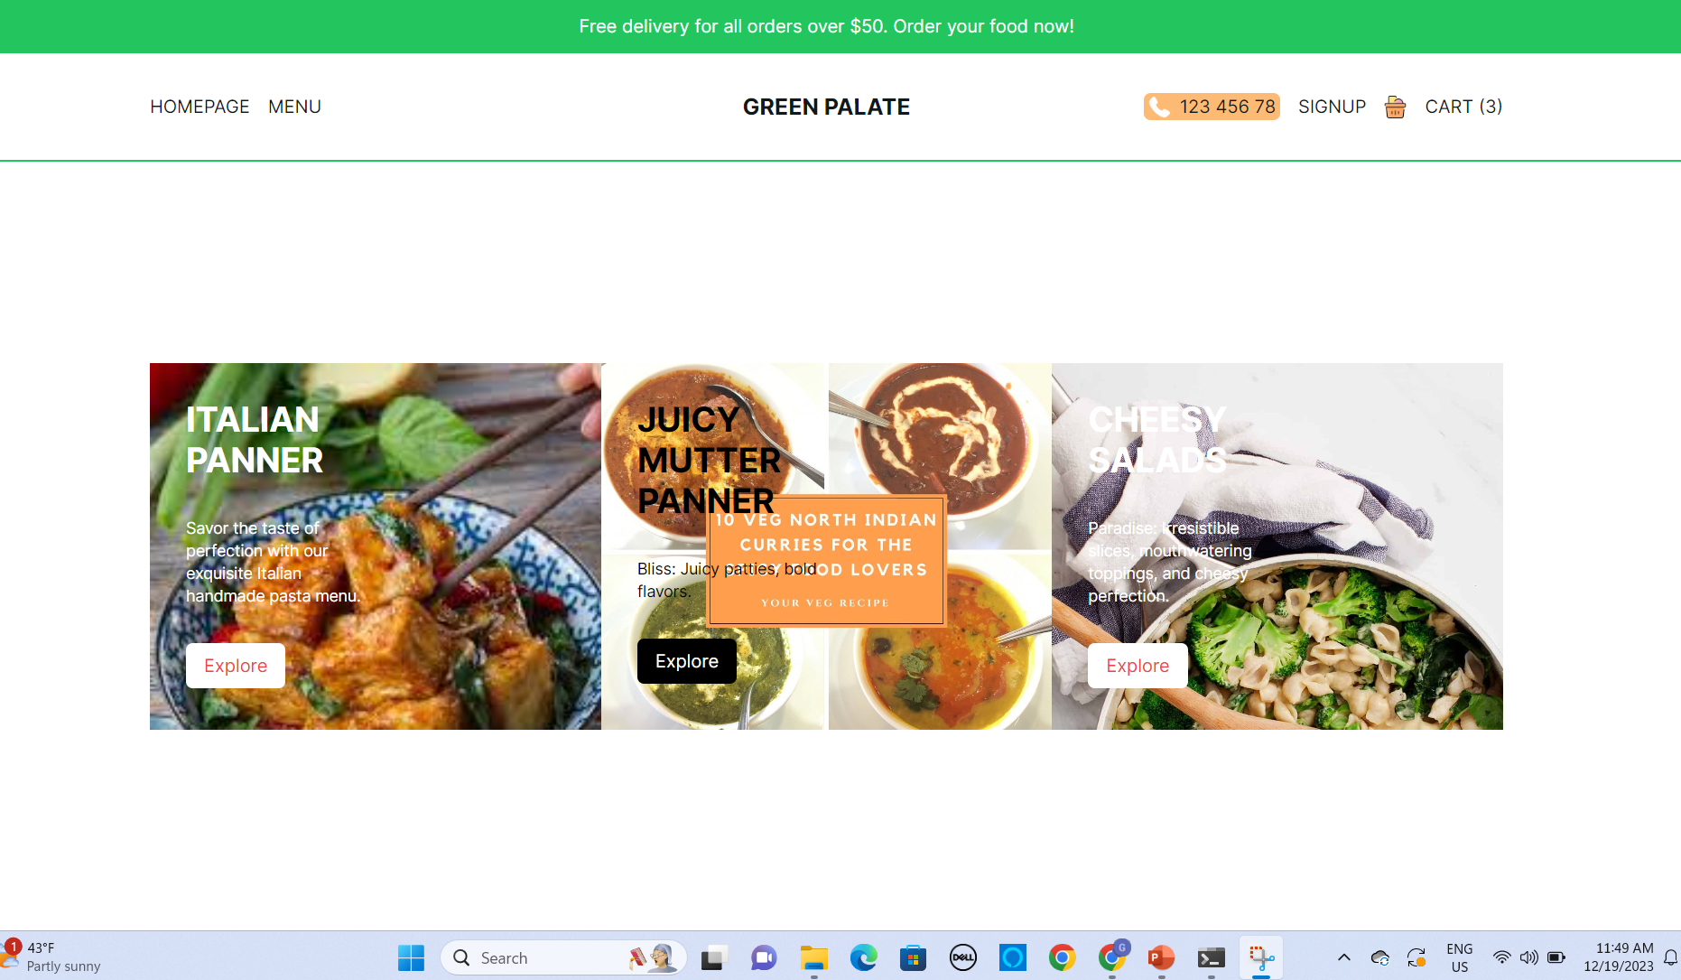

Slide 9
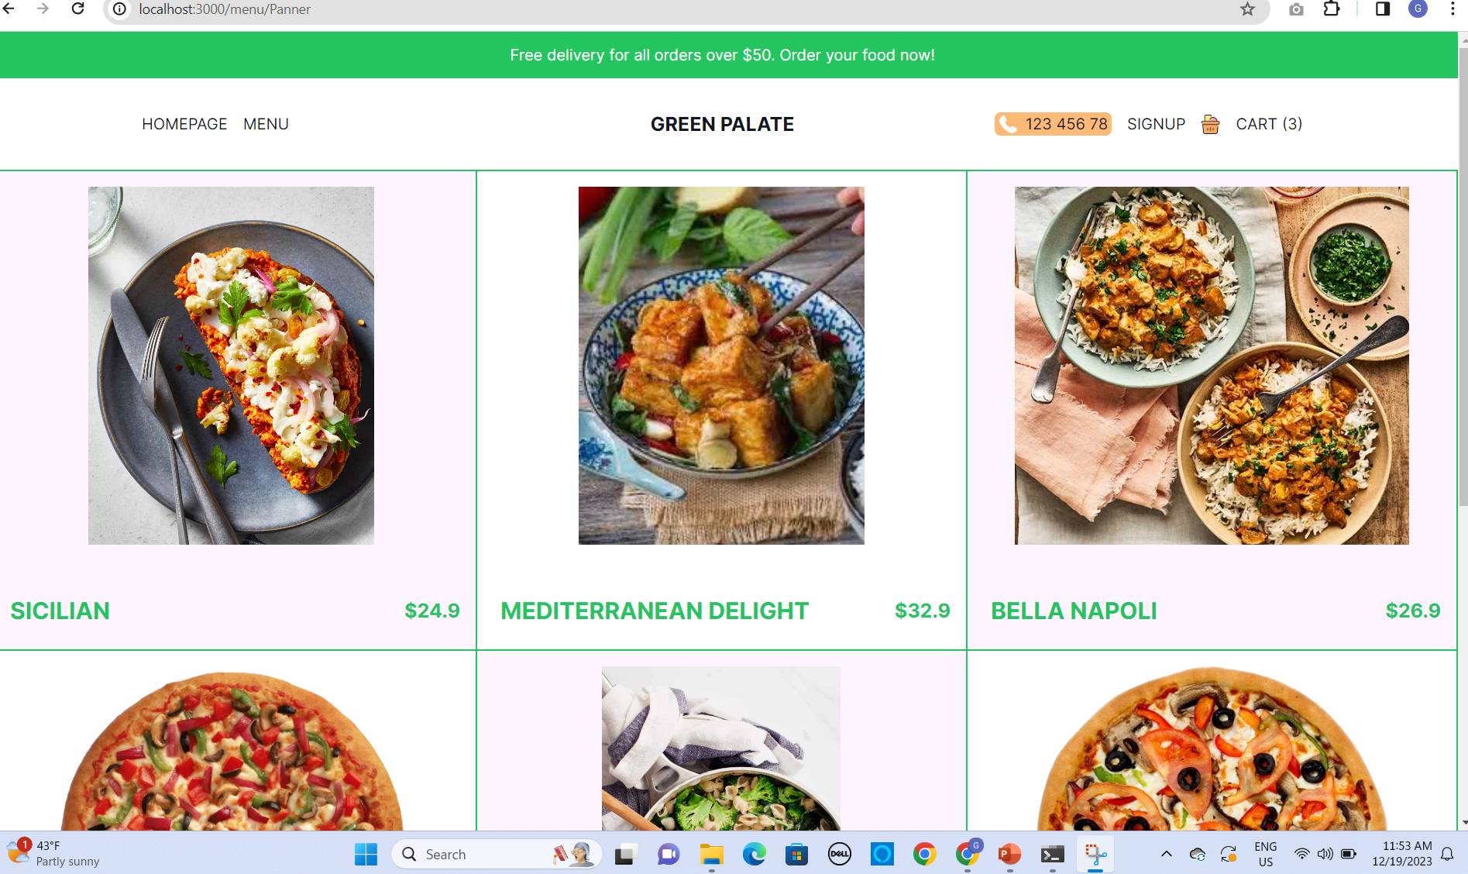

Slide 10
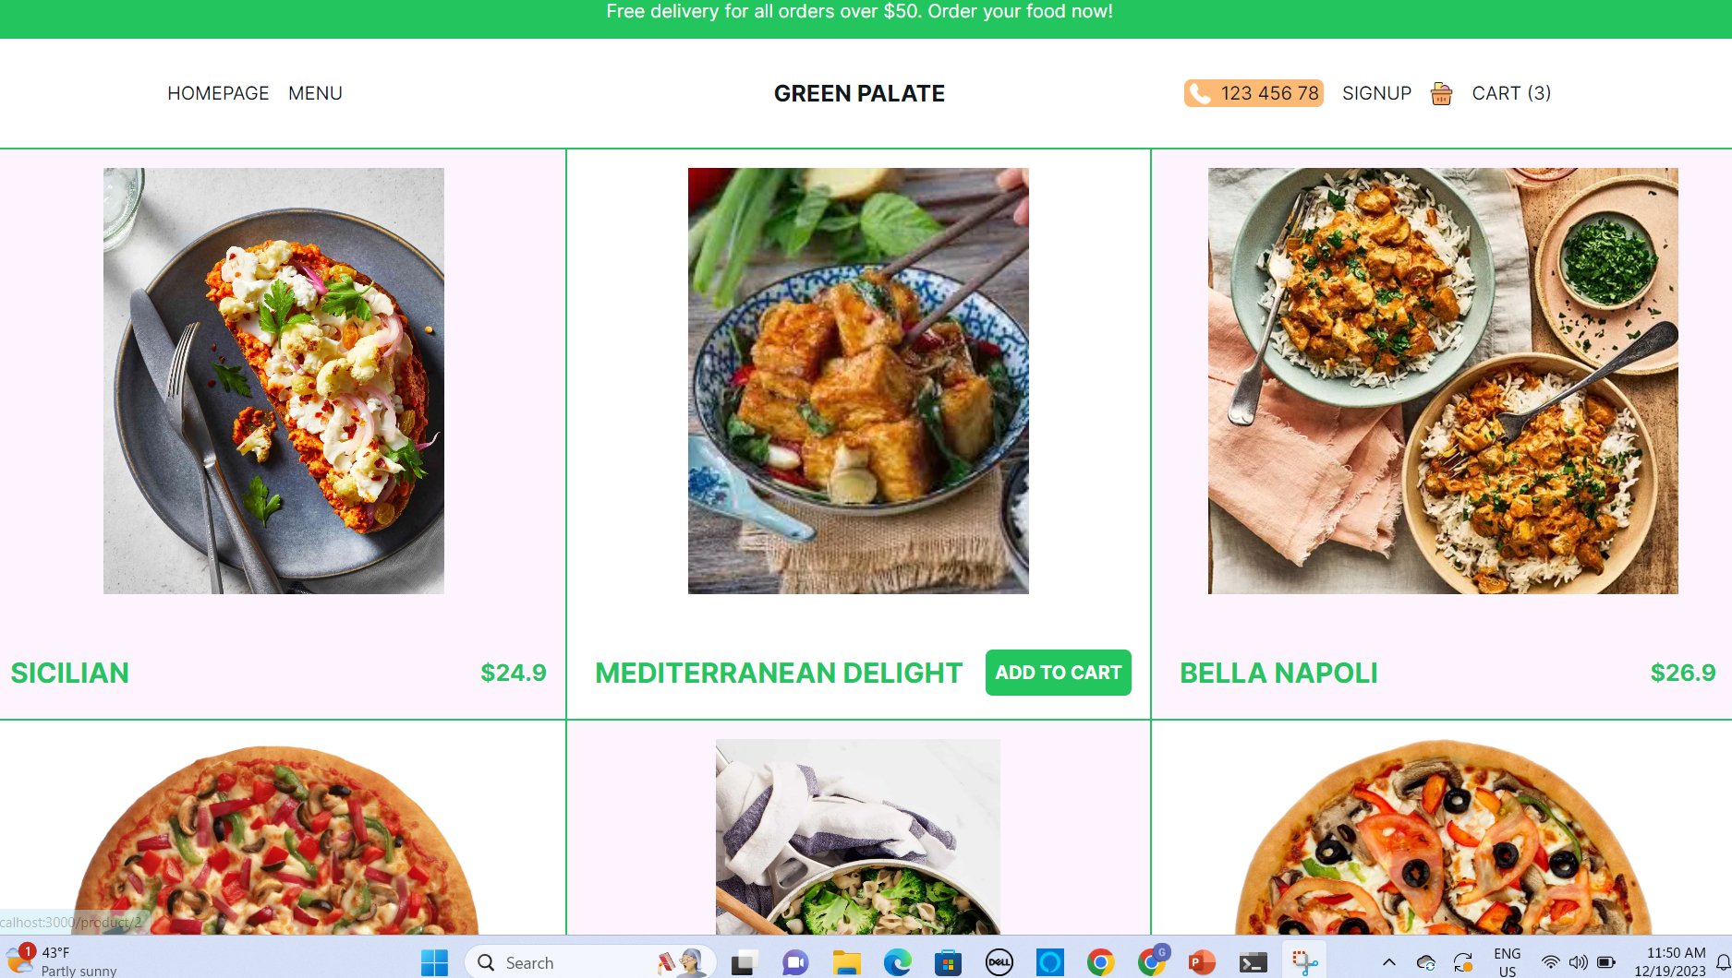

Slide 11
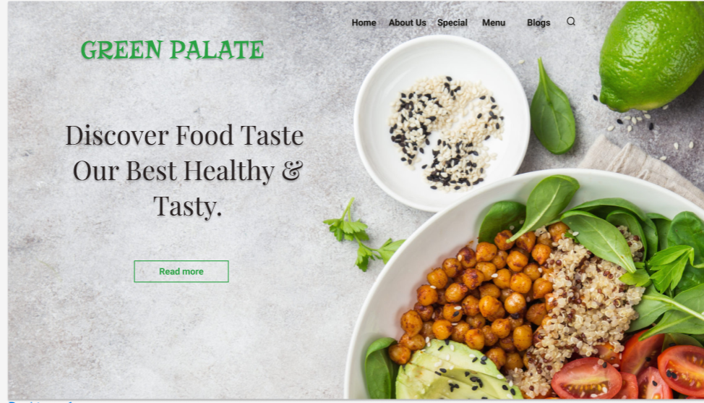
FIGMA COMPARISION

Slide 12
Sustainable Practices:
• Green Palate’s commitment to sustainability aligns values, ensuring that the ingredients are locally sourced, organic, and the packaging is eco-friendly.
Holistic Well-Being:
• The emphasis on a plant-based menu appeals to Emily’s desire for a diet that not only supports environmental sustainability but also contributes to her overall health and well-being.
Community Engagement:
• Green Palate’s involvement in local environmental initiatives and community events resonates with Emily’s desire for a sense of community and connection.

